Slide 1
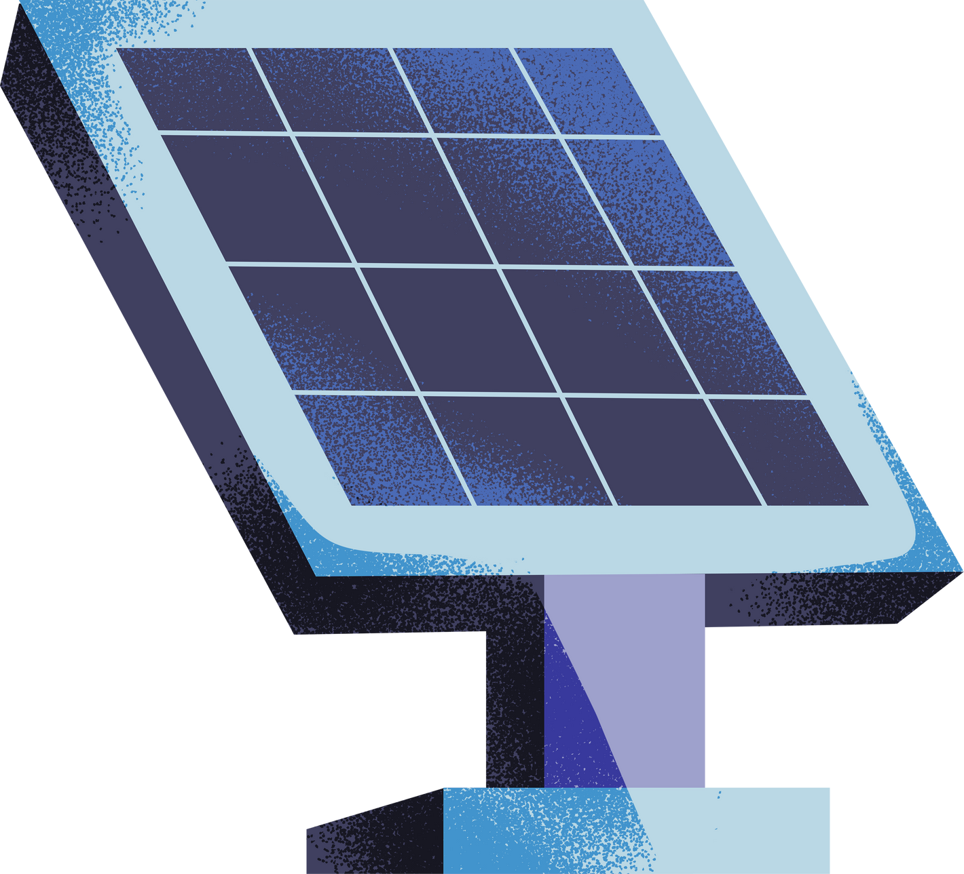
Solar Panel Defects Detection Using Computer Vision and IoT
Harnessing AI for Automated Quality Assurance in Solar Panel Manufacturing
Final Year Project

Slide 2

SolarPanels
Renewable Energy Source : Solar panels harness energy from the sun, a virtually limitless and renewable source of power.
Clean Energy : Solar power is environmentally friendly, producing no greenhouse gas emissions or air pollutants during operation.
Photovoltaic Cells : Solar panels consist of photovoltaic cells, typically made from silicon, which convert sunlight into electricity.
Long Lifespan : Most solar panels have a lifespan of 25 years or more, with minimal maintenance required.
Grid-Connected and Off-Grid Systems : Solar panels can be connected to the grid or used in off-grid systems with batteries for energy storage.

Slide 3

Challenges of Manual Solar Panel Inspection
Human Error: Manual inspection processes are prone to human error, leading to inaccuracies in defect detection and classification.
Time-Consuming: Traditional methods of inspection require significant time and effort, leading to delays in production and increased costs.
Limited Scalability: Manual inspection processes are not easily scalable to meet the growing demand for solar panels, hindering production efficiency.
Inefficiency in Defect Detection: Certain defects, such as hairline cracks or microcracks, may go unnoticed by human inspectors, resulting in undetected quality issues.

Slide 4
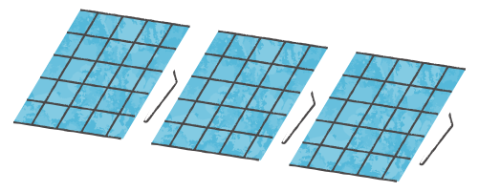
PROBLEM STATEMENT
The solar panel industry must overcome quality control challenges caused by manual inspections. Traditional methods are inefficient and error-prone, leading to performance issues and higher costs. AI/ML solutions are essential for automating inspection processes to improve efficiency, reduce defects, and ensure panel reliability. Integrating technologies like Computer Vision is crucial for streamlining defect detection and optimizing manufacturing for sustainable energy solutions.

Slide 5
Types of defects
Linear, point, and tree cracks compromise panel integrity.
Cell-scratches affect performance.
Poor soldering reduces efficiency.
VOC mismatch indicates manufacturing issues.
Dead cells diminish overall output.
Dark spots indicate potential failures.

Slide 6

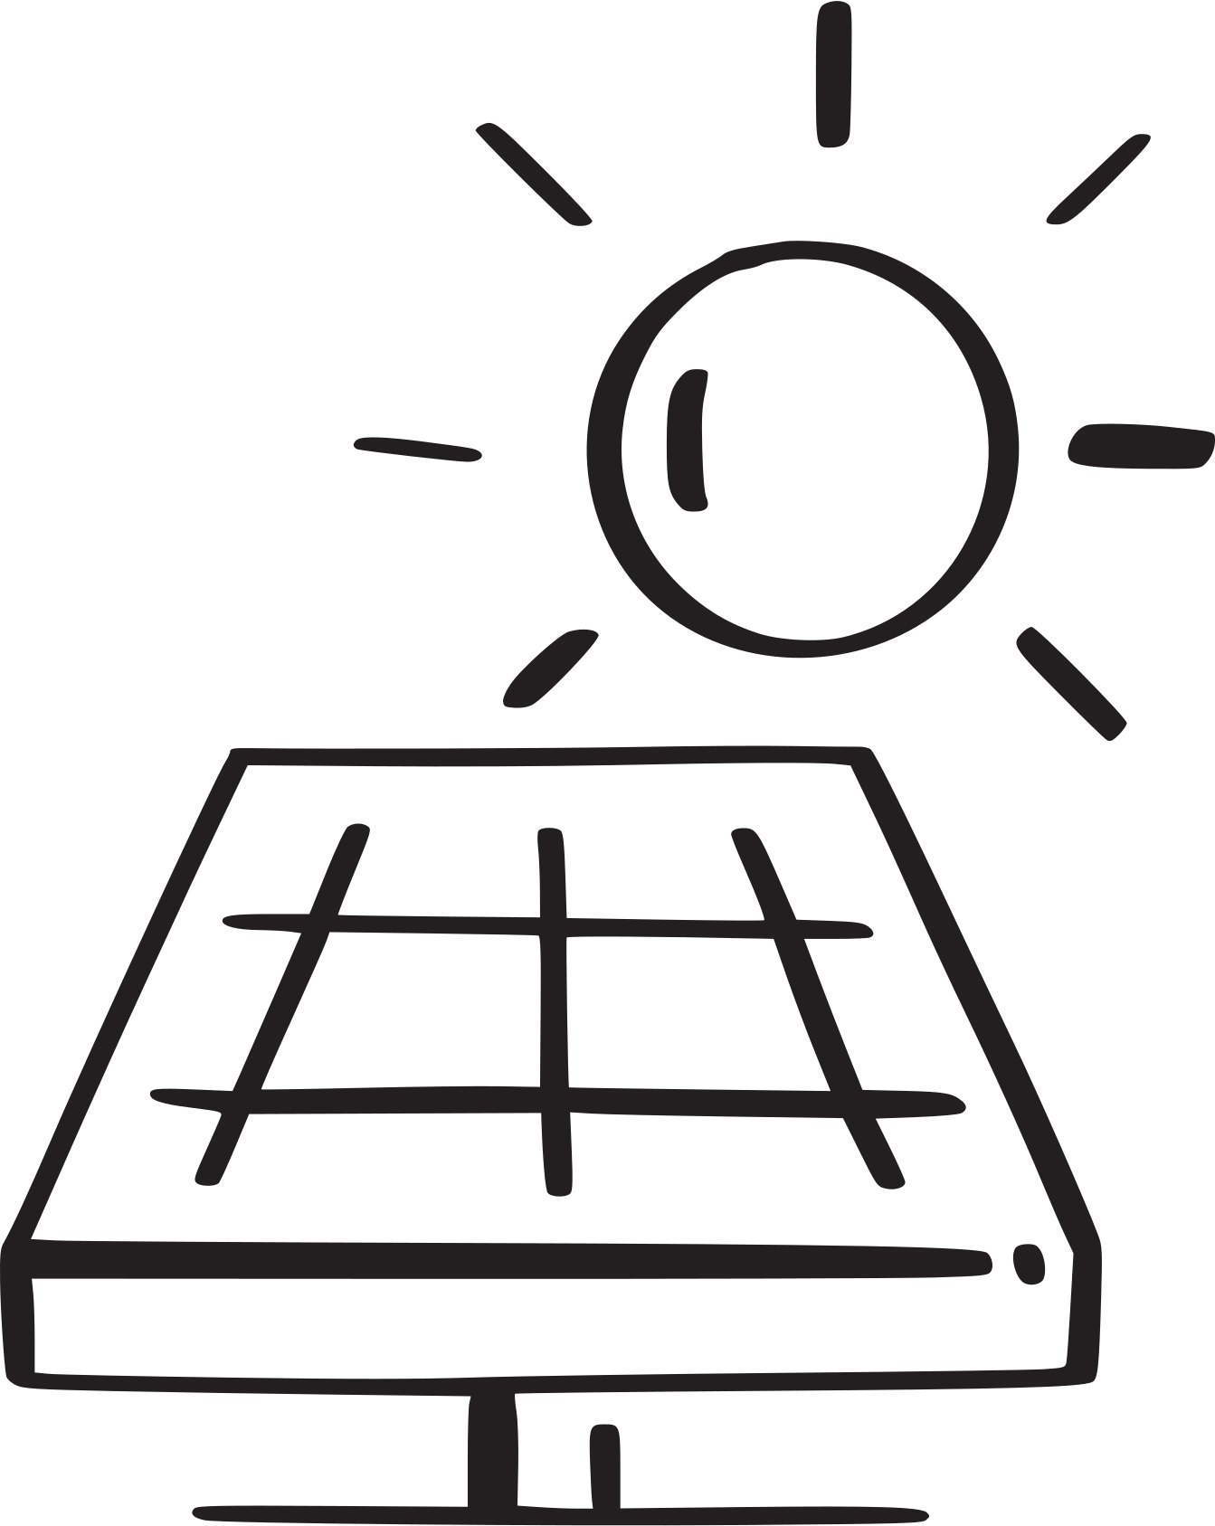
Innovative Solution: Computer Vision and IoT-powered Quality Inspection
Automated Defect Detection: Our solution utilizes cutting-edge Computer Vision algorithms to automatically detect and classify defects in solar panels, ensuring thorough quality assessment.
Real-time Monitoring: Our system provides real-time insights through an intuitive dashboard, facilitating immediate response to defect detection and reducing downtime.
Continuous Improvement: By integrating continuous monitoring and periodic model retraining, our solution consistently improves defect detection, ensuring the consistent delivery of high-quality solar panels.

Slide 7


Workflow
Data Collection:
Gather a diverse dataset of solar panel images, including defect-free and defective panels covering all specified defects.
Data Preprocessing:
Clean and enhance images to improve feature visibility and reduce noise.
Model Selection:
Choose appropriate computer vision algorithms, such as Convolutional Neural Networks (CNNs), for defect detection.
Model Training:
Train the selected model using labeled images to recognize various defects.
Model Evaluation:
Assess the trained model's performance using a separate test dataset to ensure accurate defect classification.
Integration:
Implement the trained model into the quality inspection process for automatic defect detection in solar panel images, incorporating real-time IoT sensor data for contextual analysis and decision-making.

Slide 8
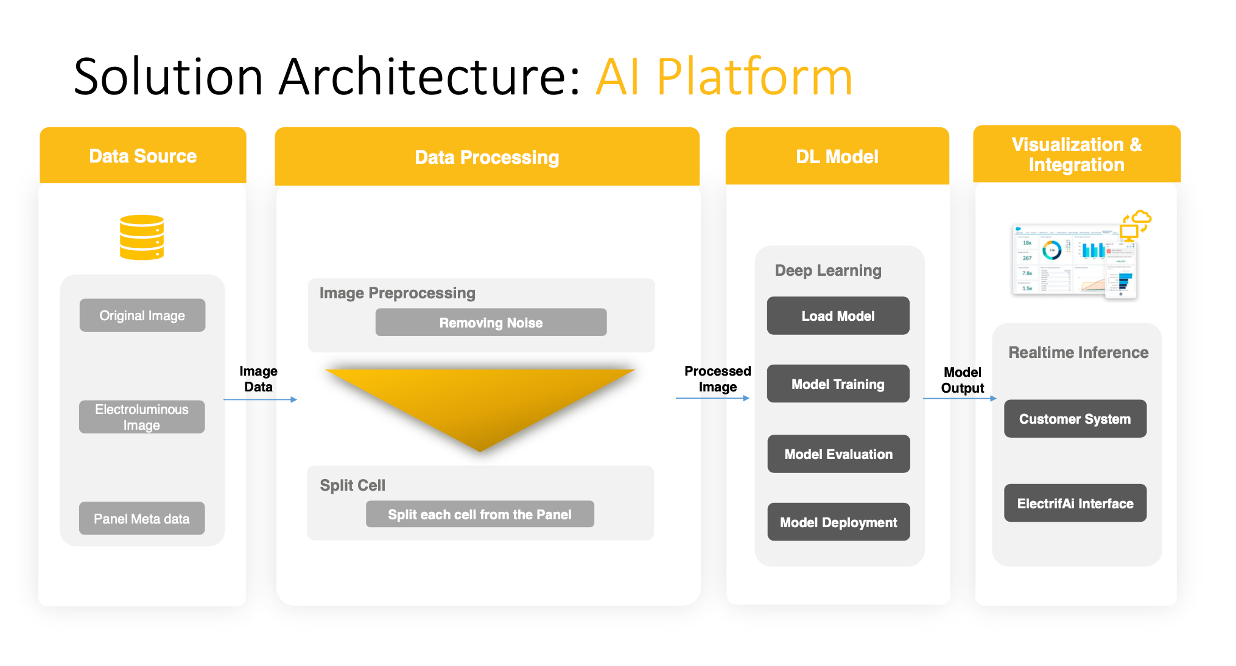

Slide 9
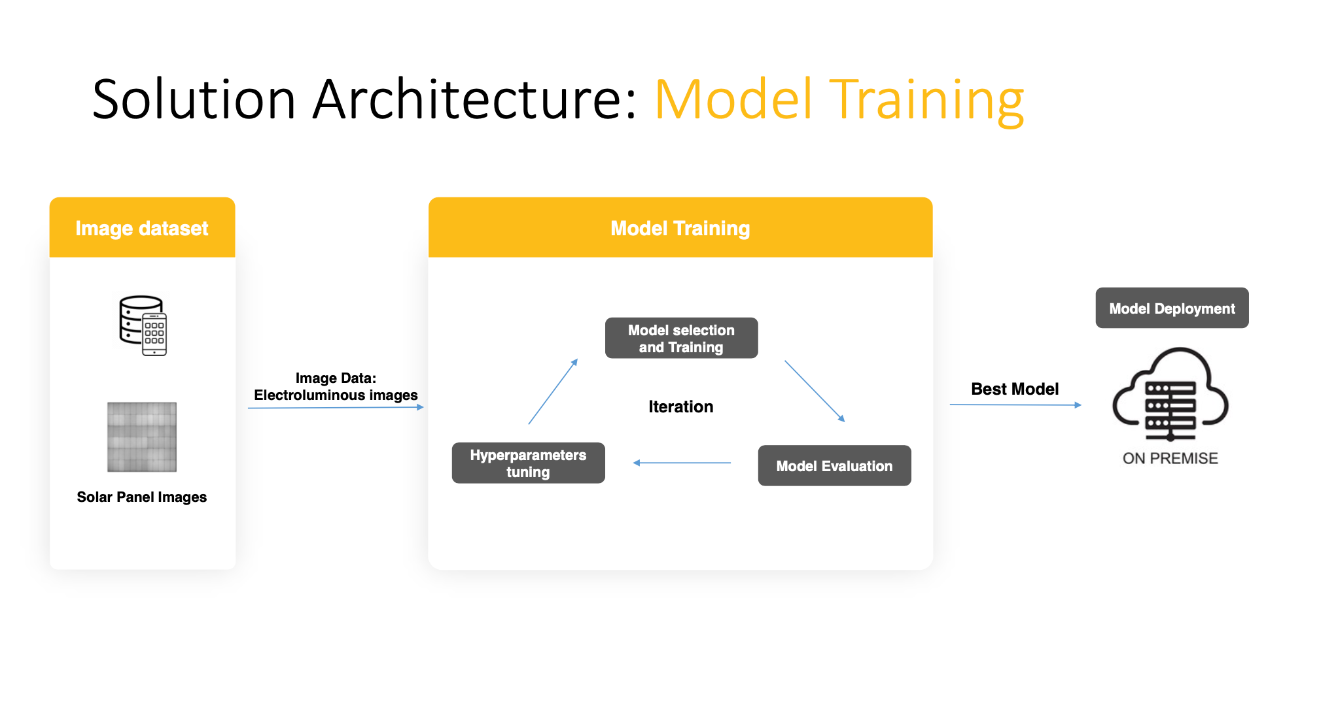

Slide 10

OUR TEAM MEMBERS
Kanishk Joshi
Sampada Agarwal
Pari Santoshi
Pari Santoshi
Navya Yadav
7

Slide 11


Thank you very much!
Project 2024

